Slide 1
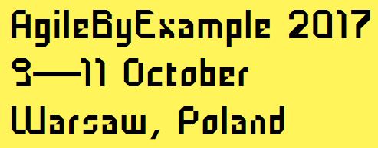
The Heart of Changing Minds
@
David Straker
Notes:
Hands up if an important part of your job is to change minds.
Keep your hand up if you’ve put proportionate effort into building your skills in this.
Persuasion is pretty much a part of everyone’s job to some degree. It’s kind of handy in life, too.
---- pre-talk notes ----
Title: The Heart of Changing Minds: The essential aspects of the skill that everybody needs.
Abstract: One of the hardest parts of many jobs is not in the planning, coding or documenting. It is in influencing and otherwise changing minds. David Straker presents experience, model and methods from 30 years of trying to figure out how to do this.
Bio: David started his work life engineering and ended in psychology, by way of teaching, coding, managing, marketing and consulting. He worked in large and small organisations, public and private, including 17 years in Hewlett Packard. Along the way he studied for a Postgraduate in Education and two master’s degrees, one in business and the other psychology. Now, he is the owner and author at ChangingMinds.org, the largest website in the world on how we change what other people think, feel, believe and do.

Slide 2

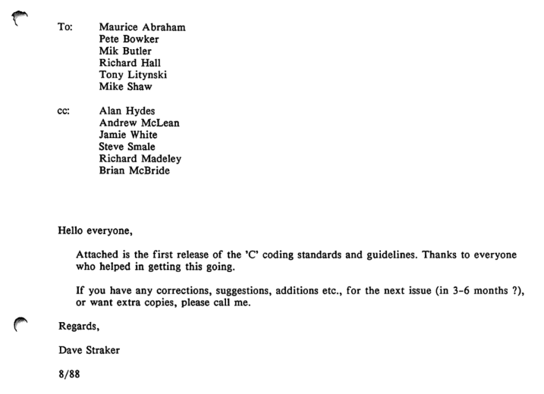

Long ago and far away…
Notes:
Long ago and far away. In 1988, I was a software engineer with HP, happily coding in my Dilbert cube. And then one day a manager sidled up to me and says ‘psst. Do you want to work in Quality?’ And I said ‘yes, why not’. It would get me out of my cubicle and around the lab.
My first job was to set up some coding standards. So I kind of did the right thing, asking everyone for their ideas and collating it all in an easy 44 page handbook. Yes. 44 pages. Hey, I was an engineer! It had to be thorough!
<click>
Here’s the original email, from 29 years ago. And guess what? Everybody said the standards were great! And then they said ‘but I’m different. I’ve got my own way of doing things.’ And nobody used them.
This was my lightbulb moment. My ITPS (It’s the people, stupid). So, like a good engineer, I threw myself into understanding people. It’s a fascinating subject and I’m still at it.
<click>
The standards didn’t go to waste. I turned them into a book, published by Prentice-Hall, which sold pretty well and got me into writing. This is why I still have the email, btw. For those interested, the book is now online.

Slide 3

Mad, bad and mystical?
Notes:
I’d not really thought about persuasion before. It seemed like some kind of evil mastermind stuff. Wicked hypnotism and all that. You are in my power. Nah. We’re not that dumb.

Slide 4
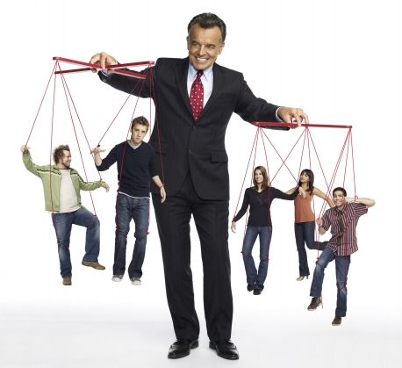
Just pulling strings?
Notes:
Is this it? Behaviourism? Pull the strings? Press the hot buttons? Pavlov all the way down?
A bit, but not a lot.
I’ve certainly seen managers act this way. And I’ve seen people getting piddled off about it.

Slide 5
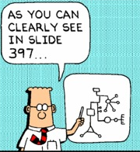
Facts (and more facts)?
Notes:
I wasn’t that great myself. This was my approach. Which was pretty much like everyone else there.
I still struggle with it. My name is David. I am a PowerPoint addict.
Is this the engineering approach? Facts are good. The problem is, they can be surprisingly unpersuasive. And more does not mean better.

Slide 6

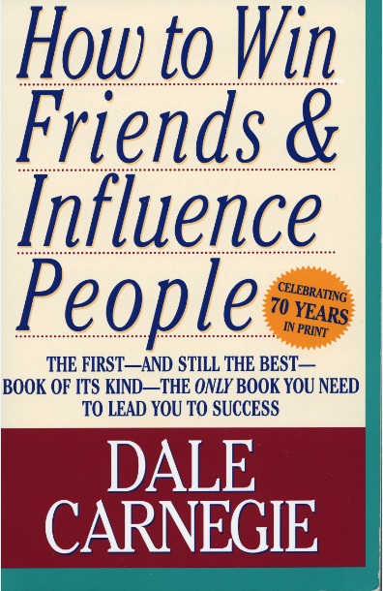
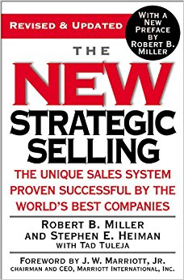
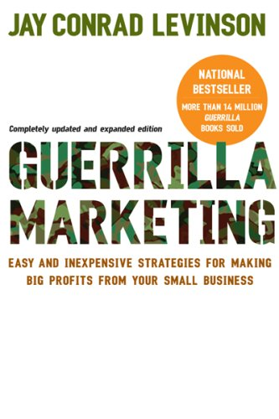

Chewing into it
Notes:
I chewed into the field. Read everything I could, across lots of disciplines.

Slide 7




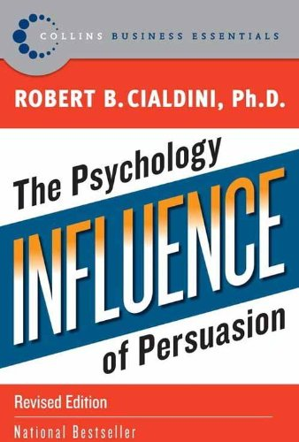
Eventually…
Notes:
I chewed around sales, marketing and all kinds of disciplines but in the end I had to bite the bullet and get into the weeds in psychology.
Someone once said ‘You can talk about girls all you like, but in the end you’ve got to ask them out.’
God help me, I even started reading academic journals. Worse: I got to like them. And I still do it!

Slide 8
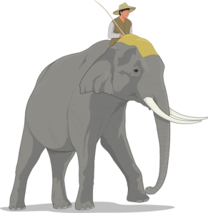
Talk to the elephant more than the rider
Conscious,
rational
Unconscious,
irrational
See: Jonathan Haidt, The Happiness Hypothesis, Basic Books, 2006
Notes:
There’s a useful model of the mind, where the rider is the conscious, rational mind, while the elephant is the unconscious, irrational mind.
Guess where the feelings come from. You can’t consciously decide to be happy or feel anything without persuading the elephant to go along with the game.
When you persuade, you need to convince the other person’s elephant far more than the rider.

Slide 9




How do people decide?
Notes:
How do we make decisions? If we understand this, then perhaps we can change minds.
<click>
Partly, we decide with our minds.
<click>
But mostly, and especially in the final decision, we decide with our emotions.
I found this very uncomfortable, I consider myself a pretty rational person. In fact it was rather an annoying thought. QED.
The bottom line is that ff you want to persuade, you have to pay attention to feelings, even more than thoughts.
Feelings are deeper than thought. It’s an animal thing. You can’t stop them. Even if you think you are, you aren’t.
So the core pattern is mostly about feelings. This is critical.
Which means if you want to persuade, your job is to change how people feel.

Slide 10
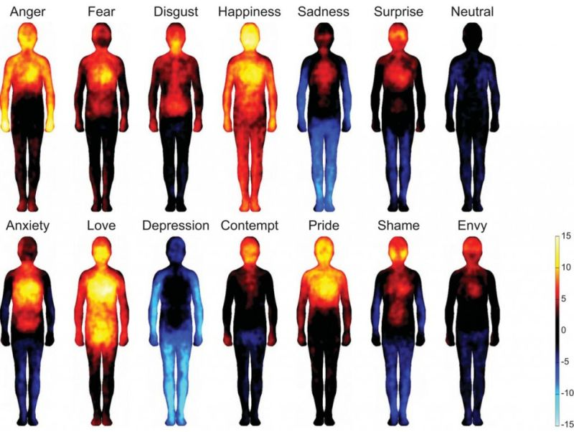
We really do feel feelings
Nummenmaa, L., Glerean, E., Hari, R. and Hietanen, J.K. (2013). Bodily maps of emotions, Proceedings of the National Academy of Sciences of the USA, 111, 2, 546-651
Notes:
Feelings are a physical thing. We label emotions but what we feel happens in our body.
‘In five experiments, participants (n = 701) were shown two silhouettes of bodies alongside emotional words, stories, movies, or facial expressions. They were asked to color the bodily regions whose activity they felt increasing or decreasing while viewing each stimulus. Different emotions were consistently associated with statistically separable bodily sensation maps across experiments. These maps were concordant across West European and East Asian samples.’

Slide 11
The Core Pattern for Changing Minds
Information
Trust
Tension
Closure
Commitment
Changing
W
orks
Notes:
So let’s look at this magical core pattern. Actually, it’s not magic and you may say ‘so what’, but the devil is, as ever, in the details. Yet even so, I’ve found that keeping this pattern in mind helps me focus when working on a changing minds subject.
<click>
The core of any method of changing minds is tension. It’s what the person feels, which is itself important. Much of the rest of this model is about feelings, which is perhaps a defining aspect. When you change minds, you work a lot with thinking, but you work even more with feelings. Tension is a visceral thing we feel in the body as well as the mind. The muscles literally tense, which is why the word is used. Tension may seem bad, but actually it can be both good and bad. Desire is usually a good tensive emotion, for example, and fear is a bad one. We’ve limited time today so for the rest of this talk we’re going to major on tension, so more about this in a minute.
<click>
Around tension there are two other factors. The first is closure. This again is a feeling, not what sales people do to you with their ‘closing techniques’. Closure is the resolution of tension, it is when a learner gets an ‘aha’ after the tension of not understanding, it’s the relief of giving in after the tension of an argument, it’s the thought of ownership as you reach for your credit card.
Tension and closure are a pair that appear in stories. In fact the building of tension and the release of closure happens all through stories and movies, coming to a grand climax at the end when all tensions are resolved in a fantastic ending.
<click>
The next part is trust, which must happen before tension. Trust is the gateway to persuasion. If you they don’t trust you, then they won’t accept what you say, and you’ll have your work cut out trying to manage tension, let alone trigging the closure you seek. You hear a lot of words around this stage, such as ‘rapport’ ‘relationship’ and ‘attention’, but the real thing that is going on is that they trust you enough to let you persuade them.
<click>
And outside this, there are two more stages.
<click>
Commitment is not always needed, but often is. When you get closure, you have agreement but not action. Much persuasion seeks to get people to do something at a later date, from going out with a romantic partner to paying for that expensive car. Even after you have got closure, you have to work on sustaining commitment. This is often a problem in business, where people say they support a change, but later reverse their decision or quietly back out.
<click>
And the final part is not a feeling, but something you must do, which is manage information. To use information means acquiring it, and imparting it in a timely way that leads to trust, tension, closure and commitment. Knowledge literally is power and if you don’t understand (and if they don’t understand) then your persuasive efforts are just toast.

Slide 12
The experience of tension
I want
I have not
I fear
What may be
Gaps
I am
I want to be
What is
What should be
Etc.
Etc.
Scalar = Σ (Gaps)
Vector = Motivation
Changing
W
orks
Notes:
So let’s have a look at just some of the tensions that are used in changing minds.
<click>
There are desire gaps (that sales people love). There are gaps where we worry about the future. There is often a gap between self-image and desired self, and so on.
<click>
A major attribute of tension as we see, is the presence of gaps, between one thought and another. And changing minds is a great deal about playing with these gaps, increasing some while decreasing others.
<click>
And the scalar tension, the total stress we feel is the sum of all these gaps. Imagine you got up in the morning and argued with your partner (gap between perfect partner and actual), then nearly had an accident on the way to work (competence gap) and then was given sugar in coffee when you don’t like it (taste gap) and then someone told you that your meeting you’d been planning for weeks has been cancelled (goal gap). You may be forgiven for exploding. Gaps are cumulative. They pile up the tension. And this, if you want to change minds, is something you should understand.
<click>
Overall, the sum of gaps

Slide 13
Yerkes-Dodson curve
Boredom
Performance
Overload
Tension-
seeking
Flow
Relief-
seeking
Performance
Collapse
Tension
Notes:
A couple of chaps by the friendly names of Mr Yerkes and Mr Dodson came up with this neat graph in 1908, where they plotted a person’s performance against the stress, or tension they felt (they called it arousal, but it’s basically the same thing and is related to the glutocorticoid ‘stress hormones’ [see Wikipedia article for research reference]).
<click>
And what they found was that more tension is good for increasing performance, but that too much tension is really bad as it not only makes a person’s performance drop, it can really crack them up.
<click>
When we have too little tension, we get bored and may actually go out looking for fun and excitement.
<click>
And then when we’ve just enough tension, everything clicks along well as the tension of interest and goals keeps us engaged. In fact we may even enter a state that Mihaly Czikszentmihalyi called ‘flow’ where we kind of lose track not only of time but even our sense of self. You may recognize this.
<click>
But then with too much tension we go into overload. Now we enter what Herbert Simon called ‘satisficing’, where our focus is not on achievement but just doing anything getting rid of the stress. Bad management can push people into this state. And as performance drops the manager thinks it is because the person is lazy or incompetent so just turns up the screws until the person cracks, which of course they eventually do. Taking days off for sickness can be hugely costly and it is mostly due to poor management. The main reason for people leaving jobs is issues with management, and the main reason for poor management is the misunderstanding of tension.
There’s some useful points here for changing minds, as one thing you can do is to first help people with their current problems. Why? Because then their tension will drop into the boredom level, so they will be willing to accept tension that you offer them. If you try to impose tensions when they are in flow or particularly overload, then you may get compliance, but you won’t change minds and you may get serious dysfunction.
Beyond this graph, there are three types of tension you may want to consider when persuading. First there’s the tensions you create by understanding human psychology and the motivations of the person in front of you. When persuading it is easy to focus just on these, but it is important to remember that people have plenty of tensions already in place. The second set of tensions are those that you can use. If they already are curious or angry or otherwise motivated about something, make use of this, bending it to your purpose. The third set of tensions are those that are distracting them away from you. Tension is a vector. It has direction. You want them pointing in your direction. So helping them resolve some of their existing tensions can not only make them grateful but also gives them space to accept your tension.

Slide 14
Tension management
Reduce
Current
Tensions
Escalate
Current
Tensions
Add
New
Tensions
Notes:
One way to use tension in persuasion is to find a current tension and turn the screws on it. This is a typical sales tactic. A typical type of message is ‘If you don’t buy our agile software your projects will fail’.
<click>
A variant on this is to add more tensions, which is what happens if you ask somebody to do something for you. ‘Could you speak at our conference’.
A problem with both of these is that they can push the person into overwhelm, with the fight-or-flight result that they either refuse or cave (though caving is not agreeing and can lead to many later problems).
<click>
A potentially very powerful alternative is to first find what tensions they are experiencing and help them resolve these. Then add your big ask. Having helped them first, they are more likely feel obliged and agree. Reducing tension also gives space in their preferred level of tension, so they accept your request in order to get back up to their comfort level.

Slide 15
Cialdini’s Six Principles
Reciprocity
Consistency
Social Proof
Authority
Liking
Scarcity
Changing
W
orks
Notes:
Professor Robert Cialdini in Michigan wrote a very influential book around 1990 called simply ‘Influence’ in which he described six key principles. So let’s take a look at these and the tensions they cause.
<click>
Reciprocity is the social rule that if I do something for you, not only must you do something for me in return, but I can also ask a favour from you, even one that is disproportionate. This is what food sellers do when they give you a taste of cheese then sell you a pound or two of the stuff. Reciprocity is a gap based on social rules and values. So we feel forced to oblige when friends ask us for help. The gap is between what I owe and what I’ve done.
<click>
Most of the time we do things that align with our beliefs, because to not do so would create an action-belief tension gap. When we do something but we do not really believe in it, then the tension of the internal gap can actually lead us to change our beliefs. This is how brainwashing works. It is also powerful force that is used in business change where getting people to do things before they really believe they are the right things to do, and can be surprisingly effective. The trick with this is to do it softly. If they do things and can justify their action as ‘I was told to do it’ then they can also justify not changing their beliefs.
<click>
Social proof is about the tension of uncertainty. When we don’t know what to do and afraid of doing the wrong thing, we look to other people. There was a famous case in the 1960s of a young woman who was beaten and killed in public but nobody even called the police (this led to the theory of ‘bystander apathy’). When nobody takes the lead, nothing happens. This is used in persuasion by creating confusion and then taking charge. A useful tip is that if you fall over or have some kind of heart problem. Don’t just yell ‘help’, as people will expect others to help. Point at a person and say ‘You in the yellow coat, call for an ambulance now!’
<click>
Authority gaps are what you feel when a policeman or manager tells you to do something (or even anyone in uniform). You obey to reduce these gaps, which are based on the rules of the country or company, but are also likely to be built into our social values, which say ‘do what authorities tell you’. This gap is also the one where we believe what we are told by experts, so becoming an expert can give you more power. This is one reason why I wrote books – people think that makes you very knowledgeable. Actually, it just means you are anally persistent. Writing books, I found, are good for getting jobs and work but not making money.
<click>
If you like me, then you trust me and will experience a gap whenever I am unhappy or in need that will motivate you to help. Liking is a principle that sales people use a lot (they also use all the other methods – I could watch a good sales person all day, and sometimes I confuse the socks off them – but that’s another story).
<click>
And finally, scarcity. We want what we haven’t got (and especially if those we like have it). We also want things which we may not be able to get again. Auctions use this principle, as do the events that shops laughingly call ‘sales’. And of course capitalism is founded on it.

Slide 16
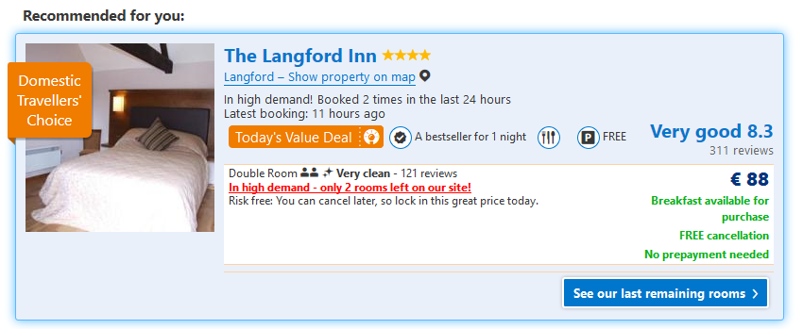
Hotel booking tensions
(Source: booking.com)
Notes:
This is a hotel near Bristol Airport. Note the scarcity and social proof pressure
Authority: Recommended for you (also elements of liking and reciprocity)
Scarcity: ‘high demand – only 2 rooms left’ + ‘last remaining rooms’
Social proof: ‘Booked 2 times in last 24 hours’ + Domestic Travellers’ Choice + 121 reviews at very clean and **** 8.3 ‘very good’ from 311 reviews (but no scoring distribution – though long tail proved ok)

Slide 17
SPIN selling
Situation
Questions
Problem
Questions
Implication
Questions
Need-Payoff
Questions
Changing
W
orks
Notes:
More recently, and in particular in business to business selling, a method called ‘SPIN selling’ is used. It deliberately fixes the problems with traditional selling.
<click>
Situation questions are about gaining information, giving the sales person ammunition to customise their subsequent spiel (and appear similar to you).
– Where have you come from? What company?
<click>
Problem questions are also about gaining information, this time in order to find a point where tension would work.
-- Why are you here? What are you looking to learn?
<click>
If I presented the solution here but you didn’t feel the tension of the problem, then all that would happen is resistance and we’d be back into objection handling.
Implication questions are designed to build tension.
-- So what happens if you go home from this conference, your manager asks ‘what did you learn?’ and you can’t think of a single thing? Is your manager then going to let you come next year?
<click>
Need-payoff questions seek to create strong closure and consequent commitment.
-- What I can tell you something now that could save your company a huge sum? Would you be ready to listen now?

Slide 18
Major tension-closure pattern
Hurt
Rescue
and
Changing
W
orks
Notes:
This is perhaps the most common pattern for changing minds and is hugely visible in SPIN.
<click>
‘Hurt and rescue’ sounds pretty unpleasant, yet this is essentially what is going on in many situations, for example:
When a parent looks sternly at an errant child, but then hugs them and says everything will be alright.
When a teacher poses difficult questions then helps the students answer them.
When a sales person reminds you of the risk of burglary before selling you insurance.
When a builder comes around to your house and takes a sharp intake of breath before telling you he can fix this terrible problem.
When a leader talks of the problems the organization is facing before outlining their brave new vision for the future.
Hurt and rescue are, after all, just tension and closure.

Slide 19
Principled Negotiation
Go to the balcony
Step to their side
Make it easy to say yes
Make it hard to say no
Deploy your BATNA
Changing
W
orks
Notes:
In negotiation, there was a programme at Harvard in the early 80s that had been commissioned by the government to find a good way to negotiation with the Russians on arms limitation. In fact it turned out to be good for all kinds of collaborative negotiation (as opposed to the typical competitive approach) and was immortalized in two books: Getting to Yes by Fisher and Ury, and Getting Past No, just by William Ury. This is an amalgam from these two books.
<click>
The first step is to ‘go to the balcony’, stepping back and looking dispassionately at the situation. This gives you clear information can also start to develop trust.
<click>
Stepping to their side is very much about trust, seeing things from their viewpoint and encouraging reciprocity. This helps build your trust, as well as theirs.
<click>
Making it easy to say yes, builds positive tension, creating desire.
<click>
If positive tension doesn’t work, then negative tension makes it harder to say no.
<click>
And last of all, you start to deploy your BATNA, your Best Alternative to a Negotiated Agreement, which is your walkaway alternative. This can be very powerful and the person with the strongest BATNA can be the one who get the most advantage from the negotiation.
In all of these, the intention is to get the person to the table for more detailed collaboration. Even when deploying the BATNA, the goal is to get them to talk, not walk.

Slide 20
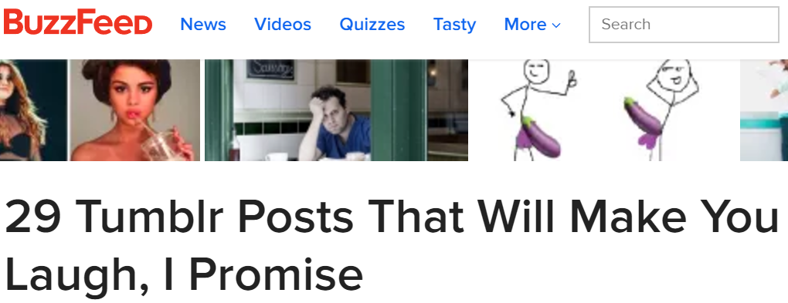
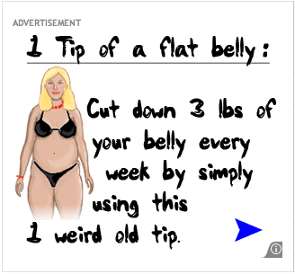
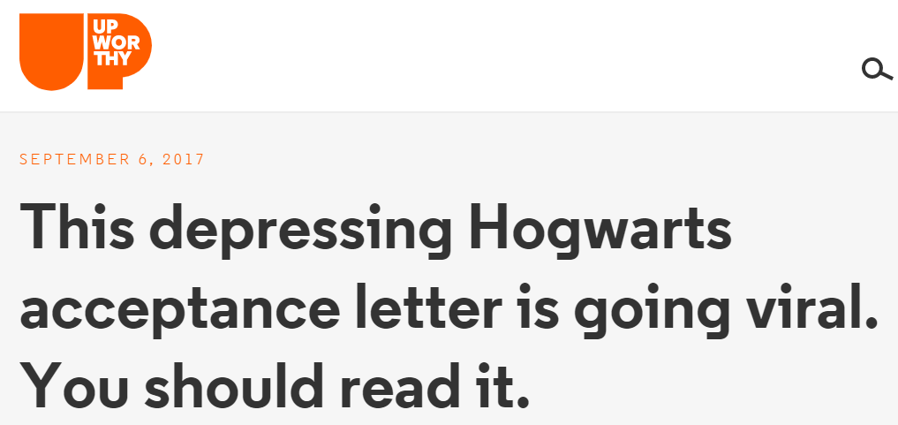
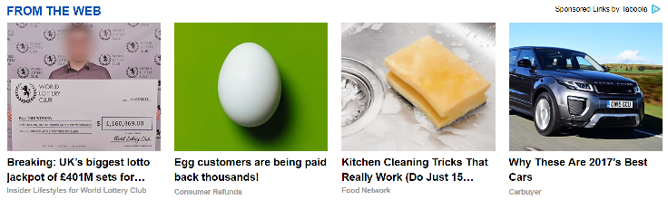
Online intensification
Notes:
Newspaper headlines have been using tension for years.
<click>
More recently, clickbait uses more subtle tensions to lure readers to click on headlines that promise humour, knowledge, health and social fun.
In particular the gap is between what you don’t have now and what clicking will soon give you.
Look at the way trust is set up in just the first one here. ‘I promise’ is a classic request for trust. More subtly, the ‘29’, as a specific number implies this is based on careful research (trust). ‘Will make’ is authority. Laugh is tension (future happiness).
<click>
Here’s one from Upworthy. Feel the pressure, Harry!
<click>
This weird old trick plays directly on a woman’s body image.
<click>
This is seamlessly added to an article in a reputable national daily newspaper. Just look at the persuasive content!
They’re all around you, every day, cranking up your tension!

Slide 21
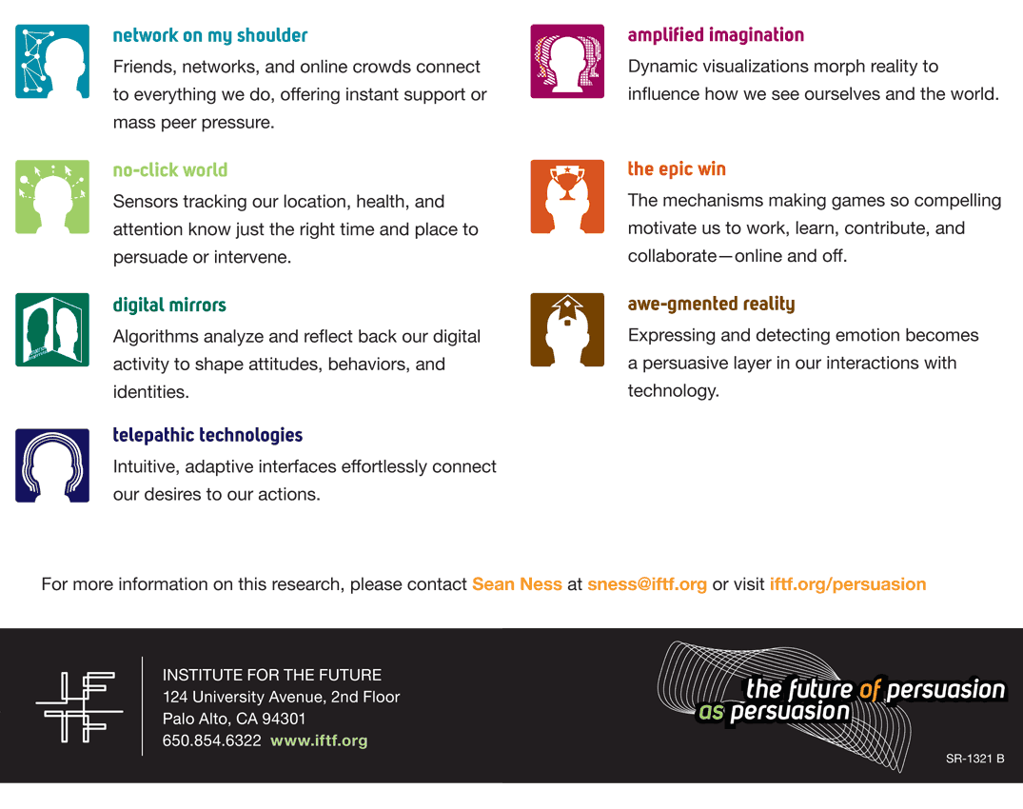
Persuasive technology
Source: http://www.iftf.org/uploads/media/FoP_lg.gif
Notes:
The machines are learning to do it too. -- And this piece from the institute for the future is seven years old.
Even if you are not persuaded, you need to know how it works, because persuasion is being automated and targeted.
Google, facebook and others know your elephant better than you do – enjoy the ride, because you’re even less in charge now.
Just look at it!
The tensions of manipulated mass peer pressure
Telepathic technologies – or at least they seem that way
And emotionally intelligent computers!
When computers can emulate empathy and we literally cannot help falling in love with them, the Turing Test will surely be conquered.
But if we know how it works, we can talk more effectively to the elephant and win the rider’s war.

Slide 22

It’s a bit like photography
Notes:
I’m a keen photographer. Photography is much like changing minds. Anyone can take a photograph. Just press the button.
It also is quite easy to get better at it. Be deliberate. Try new stuff. Notice what works and what doesn’t, and find out why.
Changing minds is like this. We all can do it. And we can all improve. And all it takes is an open mind and continuous learning.
I’ve found it a brilliant journey and I’m still working on it. As a means of becoming more successful, I can most certainly recommend it.

Slide 23

Thank You
For more, see…
http://changingminds.org
Notes:
[IF TIME, GIVE A RUN THROUGH CHANGINGMINDS.ORG]

